Slide 1
How many types of system of linear equation:-
A
1
B
2
C
3
D
4

Slide 2
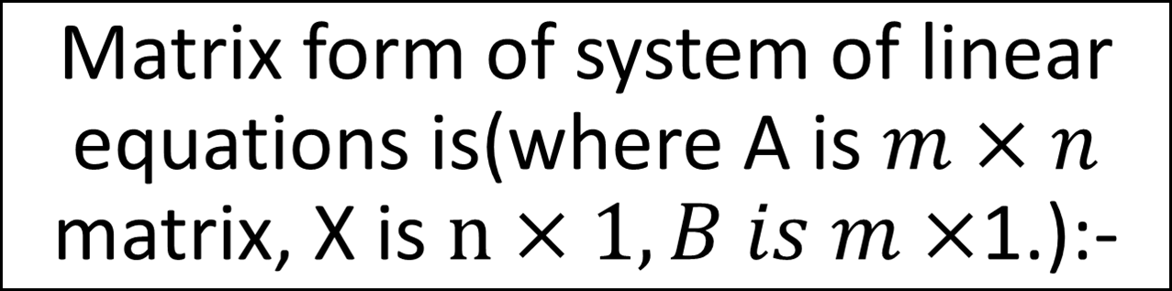



A
B
C
D
None of these

Slide 3
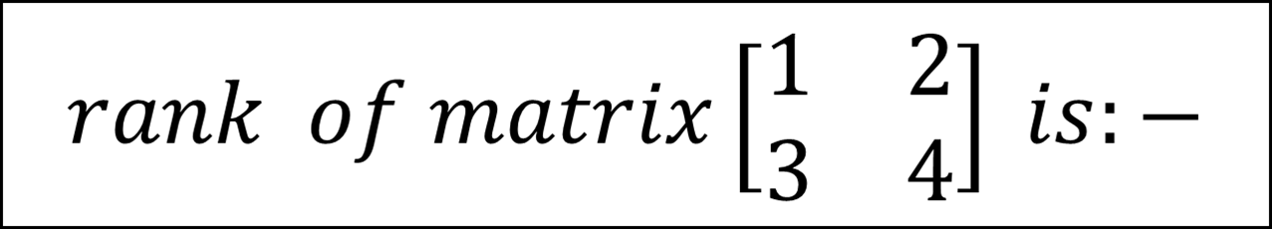
A
1
B
2
C
3
D
4

Slide 4
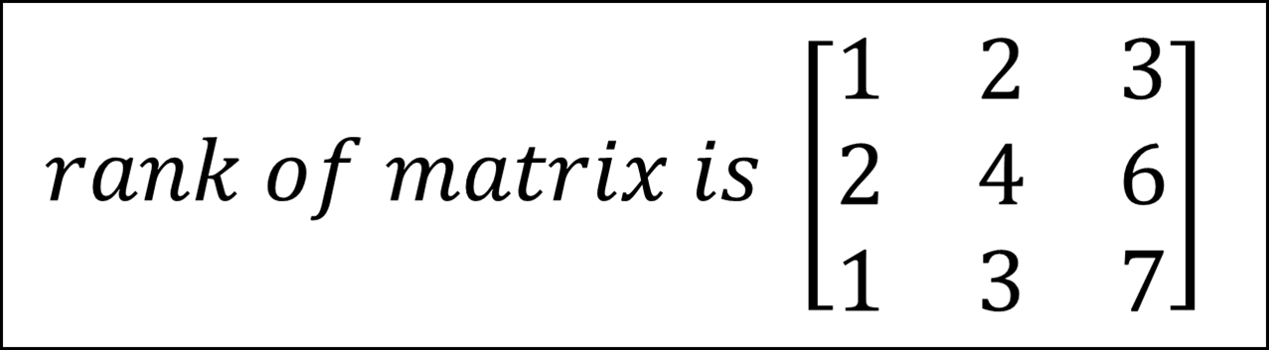
A
1
B
2
C
3
D
0

Slide 5

A
B
C
D

Slide 6
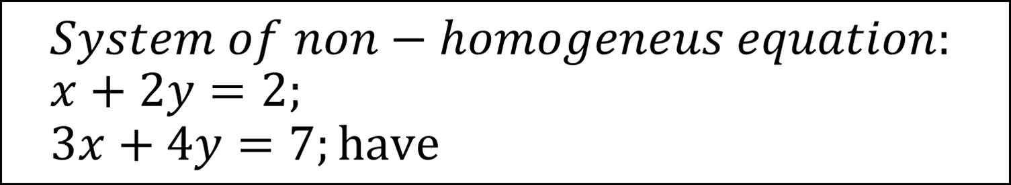




A
B
C
D

Slide 7
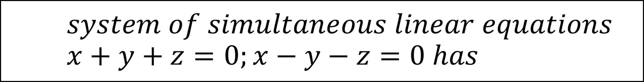



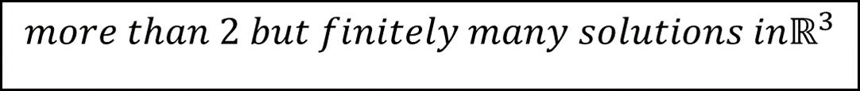
A
B
C
D

Slide 8
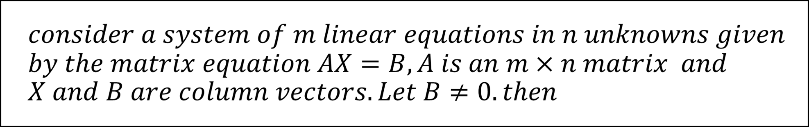
A
B
C
D

Slide 9
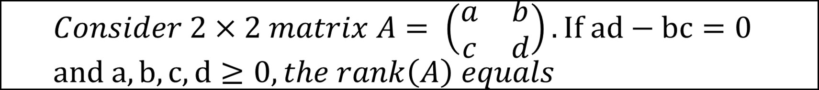




A
B
C
D

Slide 10
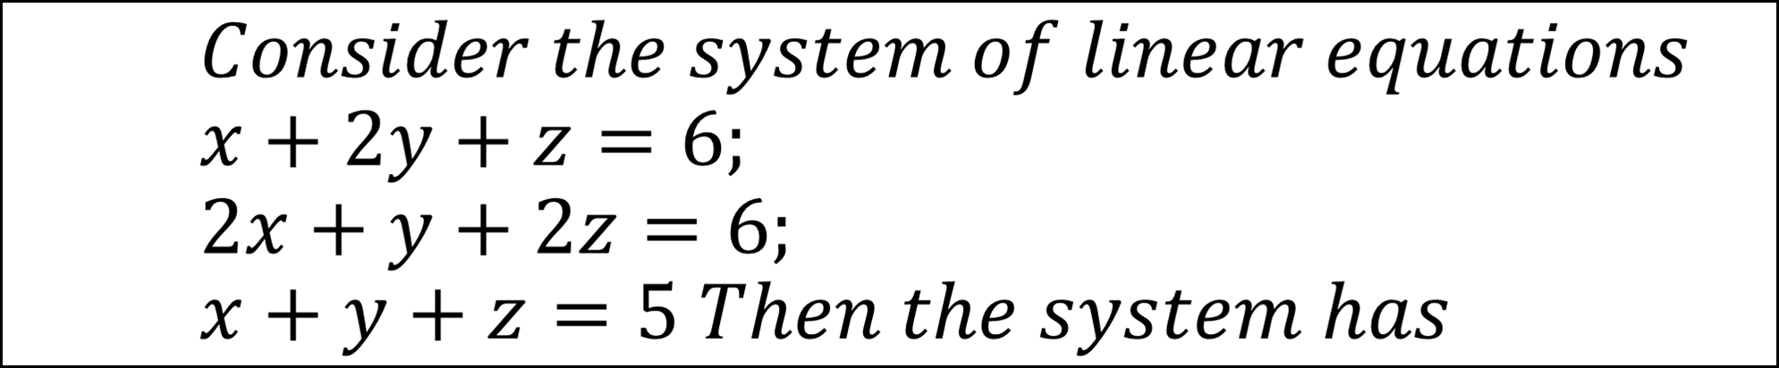




A
B
C
D

